Slide 1

Remote Patient Monitoring
(RPM) Systems – USA
Sample Report
Prepared by: Pranjal Das| 26 Nov 2025

Slide 2


SECTION 1: INTRODUCTION (1/2)
RPM Overview
Definition: Remote Patient Monitoring (RPM) uses digital technologies to collect medical and other forms of health data from individuals in one location and electronically transmit that information securely to health care providers in a different location.
Ecosystem Fit: Bridges the gap between clinical visits, enabling continuous care models.
The RPM Data Flow
Critical Role: Essential for chronic disease management (Diabetes, CVD) and post-acute care transitions.
Patient (Home)
Cloud / EHR
Provider (Action)
Sources: Grand View Research (RPM Market); CMS Telehealth & RPM Guide

Slide 3

SECTION 1: INTRODUCTION (2/2)
Classification of RPM Systems
Category | Device Types | Primary Use Cases
Vital Sign Monitors | • Blood Pressure Cuffs • Pulse Oximeters • Heart Rate Monitors • Thermometers | General health tracking, Hypertension, Post-op recovery
Special Monitors | • Continuous Glucose Monitors (CGM) • Respiratory / CPAP Monitors • ECG/EKG Patches • Fetal Monitors | Diabetes management, COPD/Asthma, Cardiology, Prenatal care
Smart Wearables
Connected Hubs
Integration of consumer & clinical grade sensors (e.g., Apple Watch, fitbit, BioButton).
Cellular-enabled gateways that aggregate data from multiple peripherals.
Sources: Fortune Business Insights (Device Segmentation)

Slide 4




SECTION 2: MARKET CONTEXT & REGULATORY (1/2)
Current Scenario in the USA
Market Drivers
$50.4 B
19.1%
Medicare/Medicaid Adoption: Strong push via expanded CPT codes for reimbursement.
GLOBAL MARKET SIZE (2024)
CAGR (2024-2032)
Chronic Disease Burden: 6 in 10 US adults have a chronic disease (CDC data).
Hospital-at-Home: Shift from inpatient to home-based recovery models to reduce readmissions.
$14.15 B
12.8%
USA MARKET SIZE (2024)
CAGR (2024 – 2030)
Tech Maturity: 5G and AI improving data transmission reliability.
Key Drivers of Adoption
Expanded Medicare coverage (CPT codes), rising prevalence of chronic conditions (60% of US adults), and the shift towards Hospital-at-Home models.
Sources: Fortune Business Insights; CDC Chronic Disease Data; MarketsandMarkets
Abbr.: CPT= Current Procedural Terminology

Slide 5
SECTION 2: MARKET CONTEXT & REGULATORY (2/2)
Regulatory Environment & Innovations
Key CPT Reimbursement Codes (2025)
Compliance & Tech Trends
Code | Description | Avg. Rate
99453 | Initial setup & patient education (One-time) | ~$19-20
99454 | Monthly device supply & transmission (16 days/mo) | ~$43-47
99457 | Remote treatment management (First 20 mins) | ~$48
99458 | Addt'l 20 mins management (Add-on) | ~$39
FDA Classification: Most RPM devices are Class II medical devices requiring 510(k) clearance.
HIPAA: Strict data encryption requirements for cloud transmission.
Recent Innovations:
AI-Enabled RPM: Predictive analytics to alert providers before an emergency.
Bio-stickers: Flexible, single-use multi-parameter patches (e.g., BioButton).
Innovation Trends
Integration of AI for predictive analytics, rigorous HIPAA compliance for cloud data, and the rise of "deviceless" RPM using smartphone sensors.
Sources: Rimidi (2025 CPT Codes); CMS Physician Fee Schedule; FDA Digital Health Center
Abbr.: HIPAA= Health Insurance Portability and Accountability Act

Slide 6














SECTION 3: COMPETITIVE ASSESSMENT (1/4)
Key Competitors Landscape
Medtronic
Philips
Dexcom
ResMed
Leader in cardiac RPM & Diabetes
Enterprise monitoring solutions
CGM Specialist (Diabetes)
Sleep & Respiratory Care
GE HealthCare
Abbott
Omron
Boston Scientific
Patient monitoring hardware
FreeStyle Libre (CGM)
Cardiovascular monitoring
Cardiac rhythm management
Sources: MarketsandMarkets (Top Companies); AVIA Marketplace Top Companies

Slide 7
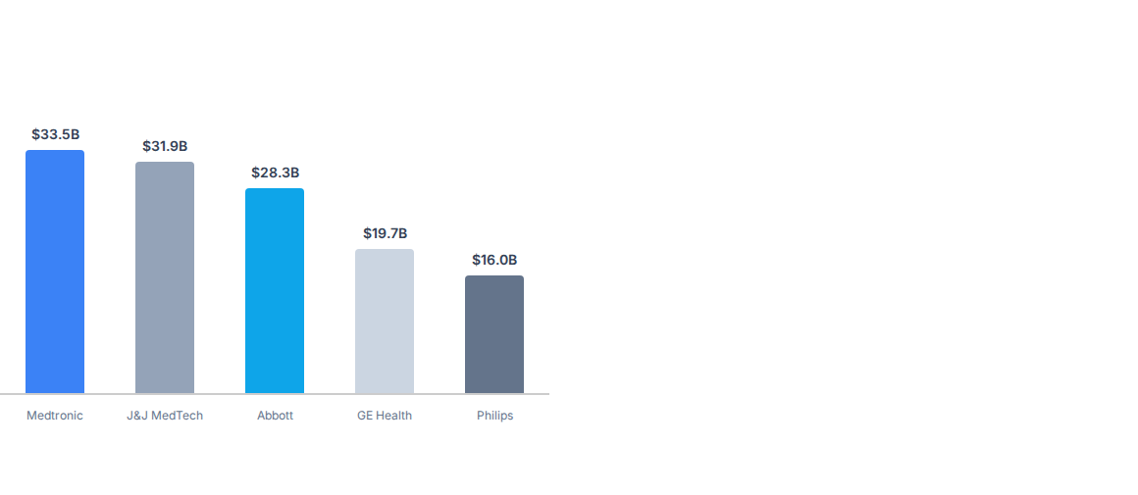
SECTION 3: COMPETITIVE ASSESSMENT (2/4)
Market Size & Share 2025(USD Mn)
Analysis
While exact RPM-specific revenue is often blended with broader segments, the total revenue of key players highlights the scale of investment capability.
Dominance: Medtronic and Abbott lead in total revenue, driven by strong cardiac and diabetes (CGM) portfolios.
Specialization: Dexcom (not shown on scale, ~$3B) punches above its weight purely in the diabetes RPM niche.
Market Concentration: The top 5 players control >60% of the structured RPM device market.
Sources: Top Medical Device Companies 2025 Revenue Data

Slide 8
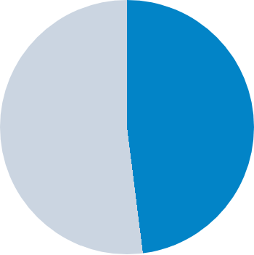

SECTION 3: COMPETITIVE ASSESSMENT (3/4)
Global RPM Market Share by Region (2024)
48%
•
North America: ~48% (Dominant)
•
Rest of World: ~52%
North America
North America dominates due to established reimbursement policies (CMS), high healthcare spending, and tech-savvy patient demographics.
Sources: Fortune Business Insights; Grand View Research Regional Analysis
Abbr.: CMS= Centers for Medicare & Medicaid Services

Slide 9
SECTION 3: COMPETITIVE ASSESSMENT (4/4)
Competitor Benchmarking
Parameter | Medtronic | Philips Healthcare | Abbott | Dexcom
Revenue (Total) 2024 | ~$33.5B (High) | ~$16.0B (Med) | ~$28.3B (High) | ~$3.6B (Low - Niche)
R&D Strength | Very High ($2.7B annual investment) | High (Focus on AI/Software) | High (Focus on Consumer Wearables) | High (Specialized in Sensors)
Geographic Presence | Global (150+ countries) | Global (Strong in EU/USA) | Global (Strong in USA/Asia) | Global (Rapid expansion)
Manufacturing | Extensive Global Supply Chain | Consolidated Hubs | Diversified | Scaling rapidly
Key RPM Focus | Cardiac & In-Hospital Monitoring | Hospital-to-Home Platforms | Diabetes (FreeStyle Libre) & Cardiac | Diabetes (G6/G7/Stelo)
Sources: Medtronic Annual Report 2024; Philips Investor Relations; Abbott Annual Reports; Dexocom Annual Reports

Slide 10




SECTION 4: DETAILED COMPANY PROFILE (1/5)
Business Snapshot: Medtronic
Financial Highlights
Company Overview
Headquarters: Dublin, Ireland (Operational HQ in Minneapolis, USA)
$33.5B
$2.7B
Founded: 1949
TOTAL REVENUE
R&D SPEND
Employees: 95,000+
Mission: To alleviate pain, restore health, and extend life.
Global Footprint: Serving over 75 million patients annually across 150+ countries.
Sources: Medtronic Annual Report 2024; Interventional News

Slide 11






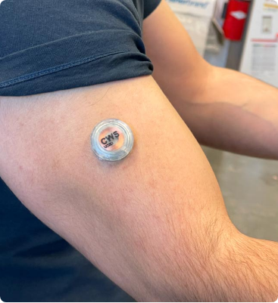
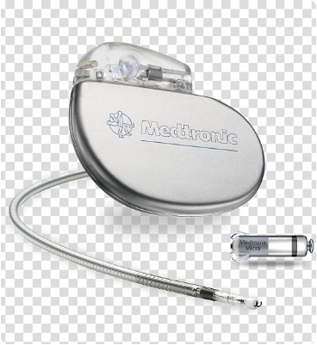




SECTION 4: DETAILED COMPANY PROFILE (2/5)
Medtronic Product Portfolio (RPM)
HealthCast™
BioButton®
CareLink™ Network
Intelligent patient monitoring portfolio connecting patients and data within the hospital and home. Focus on interoperability with EMRs.
Multi-parameter wearable for continuous vital sign monitoring (HR, RR, skin temp) at rest. Medical-grade accuracy for post-discharge.
Leading remote monitoring network for cardiac device patients (pacemakers/ICDs), allowing remote data transmission to clinics.
CareLink™ Network
Remote monitoring software connecting 2M+ patients globally.
Sources: Medtronic RPM Products; Medtronic Product Catalog

Slide 12

SECTION 4: DETAILED COMPANY PROFILE (3/5)
Medtronic Business Model
Revenue Streams
Target Payer Segments
Device Sales: Capital equipment and consumable sensors (one-time & recurring).
🏥 Hospitals & Health Systems
Service Models: "Remote Sales" teams providing virtual support and order management.
Primary customer for Acute Care & Monitoring solutions (HealthCast).
Value-Based Care: Contracts linked to patient outcomes and readmission reduction.
🏠 Home Healthcare Agencies
Growing segment for post-acute monitoring.
Primary revenue from direct device sales to hospitals and distributors. Increasing recurring revenue from SaaS subscriptions (CareLink) and service contracts.
🚑 Payers (Insurance)
Direct reimbursement for diabetes and cardiac management.
Sales Channels
Direct: Large hospital networks & IDNs.
Distributors: Global supply chain partners.
Direct-to-Patient: Emerging channel for diabetes consumables.
Sources: PitchGrade Medtronic Business Model Analysis; Medtronic Investor Presentation 2024

Slide 13
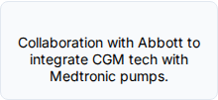
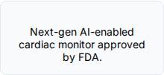
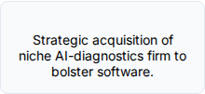

SECTION 4: DETAILED COMPANY PROFILE (4/5)
Recent News & Activities
Strategic Spin-off (Intention): Medtronic announced plans to separate its Patient Monitoring and Respiratory Interventions businesses into a new independent company ("NewCo") to unlock value and focus on core cardio/neuro assets.
Awards: HealthCast™ intelligent patient monitoring won the "Best New Technology Solution" at the 2024 MedTech Breakthrough Awards.
AI Integration: Continued partnership with AI firms (like Cosmo Pharmaceuticals in endoscopy) and internal development of AI algorithms for cardiac monitoring alerts.
Product Launch: Ongoing rollout of the Evolut™ FX+ TAVR system, supported by remote monitoring capabilities for post-op care.
Q3 2024
Q1 2025
Q2 2025
Future
Partnership
Product Launch
M&A Activity
Expansion
Sources: Medtronic Spin-off Announcement; Medtronic Newsroom, Medtronic Press Releases; FierceBiotech

Slide 14




SECTION 4: DETAILED COMPANY PROFILE (5/5)
SWOT Analysis: Medtronic
Strengths
Weaknesses
•
Market Leader in Cardiac Rhythm Management (CRM)
•
Recent product recalls (e.g., respiratory devices)
•
Massive R&D budget ($2.7B) driving innovation
•
Slower growth in Diabetes vs competitors (Dexcom)
•
Diversified portfolio reduces reliance on single product
•
Complex organizational structure
Opportunities
Threats
•
Expansion in emerging markets (APAC)
•
Intense competition (Abbott, nimble startups)
•
"NewCo" spin-off allows sharper focus on RPM
•
Pricing pressure from hospital procurement groups
•
AI-driven predictive diagnostics
•
Regulatory hurdles (FDA/MDR) delaying launches
Sources: Investing.com SWOT Analysis; SWOT & pestle analysis; PitchGrade Medtronics Analysis

Slide 15




SECTION 5: MARKET DYNAMICS (1/3)
Market Dynamics (DROC)
Drivers
Opportunities
Rising geriatric population (1 in 6 people worldwide by 2030)
Need to reduce hospital readmission penalties
Expansion into rural telehealth markets
Integration of RPM with behavioral health
Restraints
Challenges
High initial cost of implementation for health systems
Lack of standardized interoperability between devices
Ensuring data privacy (cybersecurity threats)
Maintaining patient adherence/compliance with devices
Sources: Precedence Research Market Dynamics; MarketsandMarkets RPM Report; Grand View Research

Slide 16

SECTION 5: MARKET DYNAMICS (2/3)
Deep Dive: Rise in Chronic Diseases
The Burden of Chronic Illness
The primary catalyst for RPM adoption is the sheer volume of patients requiring long-term management rather than acute episodic care.
60%
OF US ADULTS HAVE AT LEAST ONE CHRONIC DISEASE
Prevalence: 90% of the US annual healthcare expenditure ($4.1 Trillion) is for people with chronic and mental health conditions (CDC).
Impact: Diabetes, Heart Disease, and COPD require daily monitoring.
40%
Solution: RPM shifts the data collection from "snapshot" (clinic visit) to "continuous movie" (home monitoring), allowing early intervention.
HAVE TWO OR MORE
The US population aged 65+ is projected to nearly double by 2050. This demographic consumes 3x more healthcare resources.
Stat: 6 in 10 US adults have a chronic disease.
Sources: CDC National Center for Chronic Disease Prevention; CDC Chronic Disease Data; US Census Bureau

Slide 17


SECTION 5: MARKET DYNAMICS (3/3)
Deep Dive: Reimbursement & Data
Reimbursement Variability
Data Privacy & Security
While CMS has established codes, variability remains among private payers and Medicaid across states.
As devices move into the home, the attack surface expands.
•
Cybersecurity: IoT devices are often less secure than hospital-grade equipment.
•
Documentation Burden: Strict audit trails required to prove "16 days of data" were collected.
•
Interoperability: Siloed data formats make it hard to integrate RPM data directly into the patient's main Electronic Health Record (EHR).
•
Rule Changes: Yearly updates to Physician Fee Schedules create uncertainty for long-term ROI planning.
Sources: ThoroughCare Billing Rules; Cybersecurity Reports

Slide 18

Conclusion & Strategic Outlook
Strategic Recommendations
Invest in AI/ML: Hardware is becoming a commodity; value lies in data interpretation.
Market Position Summary
The US RPM market is in a high-growth phase (CAGR ~19.1%), transitioning from a "nice-to-have" pilot to a "standard-of-care" necessity. Growth is fueled by reimbursement clarity and the undeniable economics of preventing hospital readmissions.
Focus on Usability: Devices must be "passive" and require minimal patient effort to ensure compliance.
Secure the Data: Prioritize SOC2/HIPAA compliance to win hospital trust.
5-Year Outlook
Expect consolidation of niche device players by major tech firms. AI will shift RPM from "monitoring" to "predicting," reducing the alert fatigue for clinicians.
Sources: XYZ Research Internal Analysis [Role Play]

